Slide 1
Mining Sales Data for Decision Making
August 2019

Slide 2
2
What we addressed…

Slide 3
3
Questions we helped the sales team answer:
Insights about customer purchasing behavior:
Do customers in different regions spend more per transaction? Which regions spend the most/least?
Are there differences in the age of customers between regions? If so, can we predict the age of a customer in a region based on other demographic data?
Is there any correlation between age of a customer and if the transaction was made online or in the store? Or do other factors correlate to an online or in-store transaction?
Is there a relationship between the number of items purchased and amount spent?

Slide 4
4
Questions we helped the sales team answer:
New products should we offer:
Given sales’ shortlist of 17 new products, what are the top 5 we should offer?
What is the predicted profitability of these shortlisted products?

Slide 5
5
How we did it…

Slide 6
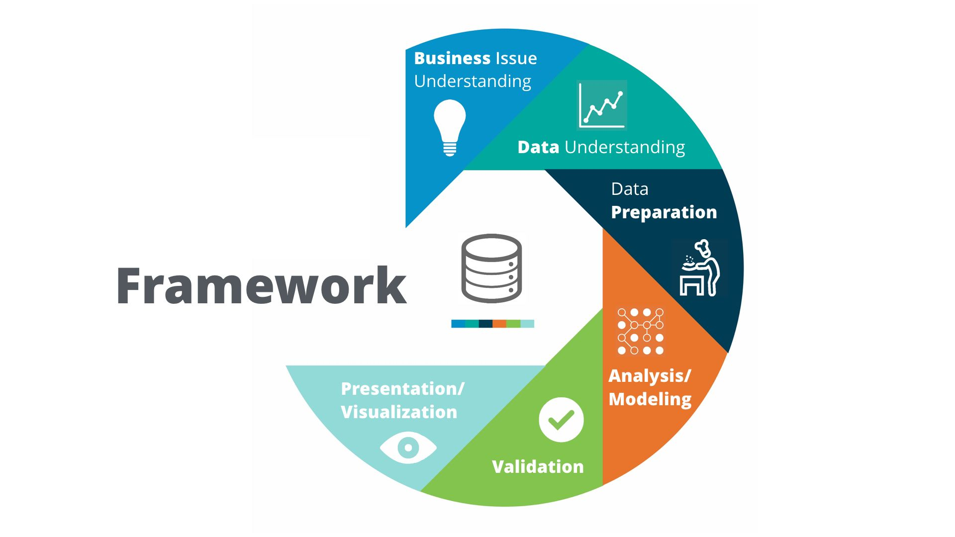

CRISP - DM (Cross-industry standard process for data mining)
6
RapidMiner Named a Leader in Gartner’s 2019 Magic Quadrant for Data Science and Machine Learning Platforms for Sixth Consecutive Year.
“Gartner Magic Quadrant for Data Science and Machine-Learning Platforms,” by Carlie Iodine, Peter Krensky, et al., January 28, 2019.
https://www.kaggle.com/ananta/solving-data-science-problems-using-crisp-dm

Slide 7
7
What we discovered…

Slide 8
8
Results –Customer Buying Patterns
Decision Tree Model – Online vs In-store
84.5% confident in model results
If current trends continue
Amount Spent in Transaction is Key
More than $1,998.90 = Online
Less than $1,990.80
Age - older than 74.5 (Online)
Next, Region determines behavior
West – all online purchases
Central – age group
East – dollar amount
South – dollar amount then age

Slide 9
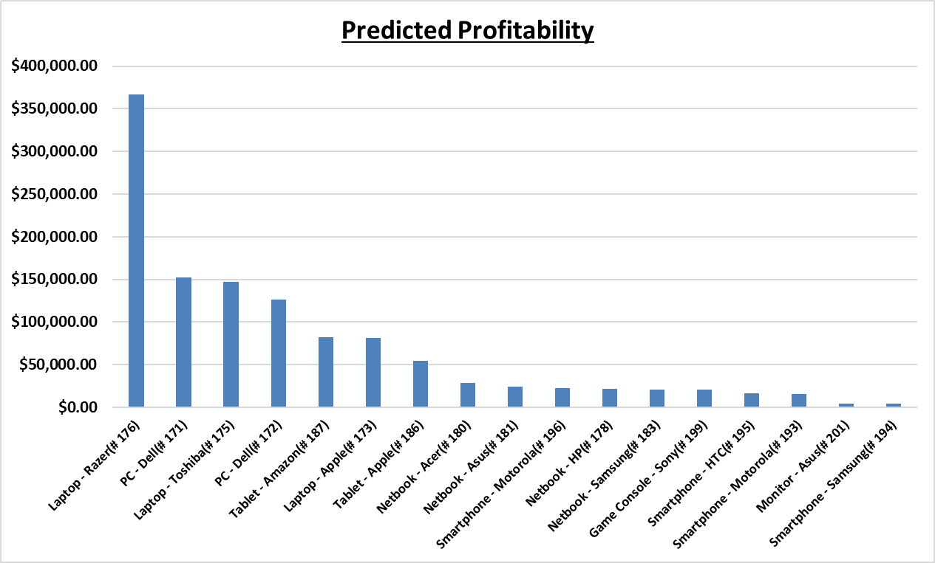
9
Results – New Product Profitability
Top 5 Potential Products | Predicted Profitability
Laptop – Razer (# 176) | $366,728.07
PC – Dell (# 171) | $152,218.15
Laptop – Toshiba (# 175) | $147,405.58
PC – Dell (# 172) | $126,428.12
Tablet – Amazon (# 187) | $82,053.32
74.9% confident in model results
As long as current trends continue

Slide 10
10
Other questions data mining can help answer…

Slide 11
11
Other ways data mining can help to improve our business
Leverage a combined demographics and product sales data set to investigate how well certain products sell to certain demographics
Combining what we learned with our initial data analysis on demographics to build a business plan to increase sales
Area of interest: Product Recommendations
Possible with use of Machine Learning, but also doable with just data mining
Gives us better potential to cross-selling

Slide 12
12
Thank you!

Slide 13
13
Appendix

Slide 14
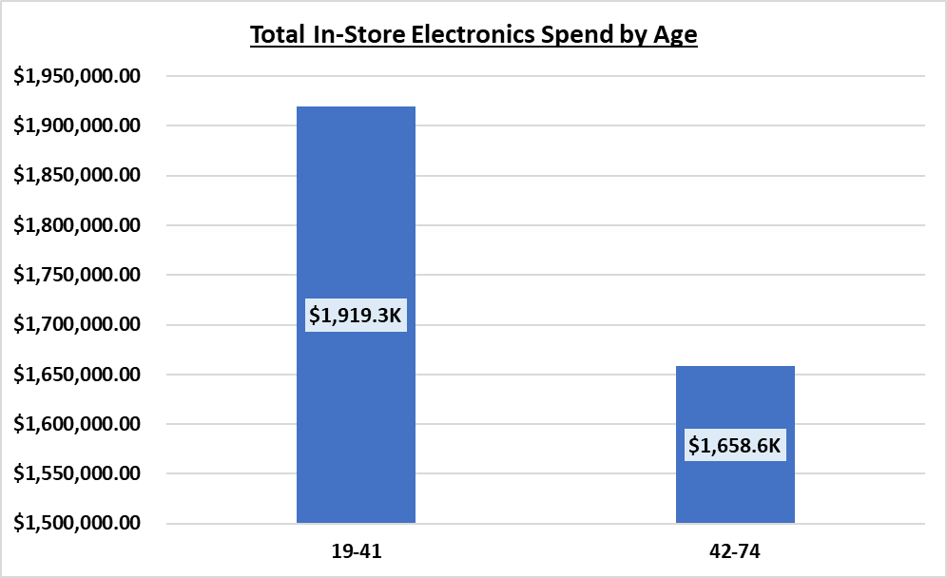
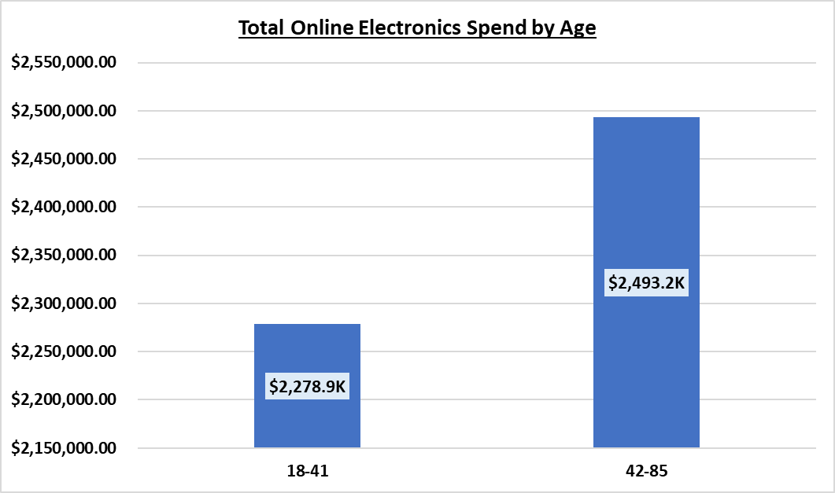
Age & Purchase Location Assumptions
Older Customers Shop More In-Store
Customers Spend More on Electronics
19 - 41 = 53.6% of In-Store Sales
AVG Spend Per Transaction
19 – 41 = $865.32
42-74 = $709.73
18 – 41 = 50.3% of Electronic Spend
AVG Spend Per Transaction
18 – 41 = $981.57
42 – 85 = $725.47

